Slide 1

Project on Fundamental Stock Market Analysis
Name: Chandrakanth, Vamshi Varma and Joshi Sriram
Batch: 261-264
Website: Groww

Slide 2


Stock Market
The stock market is a centralized marketplace where buyers and sellers trade shares of publicly listed companies. It serves as a platform for companies to raise capital by issuing stocks and for investors to buy ownership stakes in those companies.
> In this project, we are going to represents the fundamental analysis on the Stock market. We are going to compare the data from the Market cap size, P/E ratio, return on equity, P/B ratio and other details.

Slide 3


Overview
Collecting real-time or historical data on Indian stock market prices and volumes.
Analyzing the performance of specific stocks or sectors.
Identifying patterns on fundamental analysis on market data between industries
Creating visualizations to present the data in a meaningful and understandable way.
Drawing insights to inform investment decisions or understand market behavior.
Problem Statement
Analyzing the Indian stock market trends right now through web scraping to gain insights into stock performance, and trends.
The key point is to represent the stocks which are performing well and can be invested.

Slide 4






What is Web scraping?
Web scraping is the automated process of extracting data from the websites. It involves writing code to retrieve specific information from web pages and converting it into a structured format (such as CSV, JSON, or a database) that can be analyzed and used for various purposes.
Following libraries were used to Analyze data

Slide 5
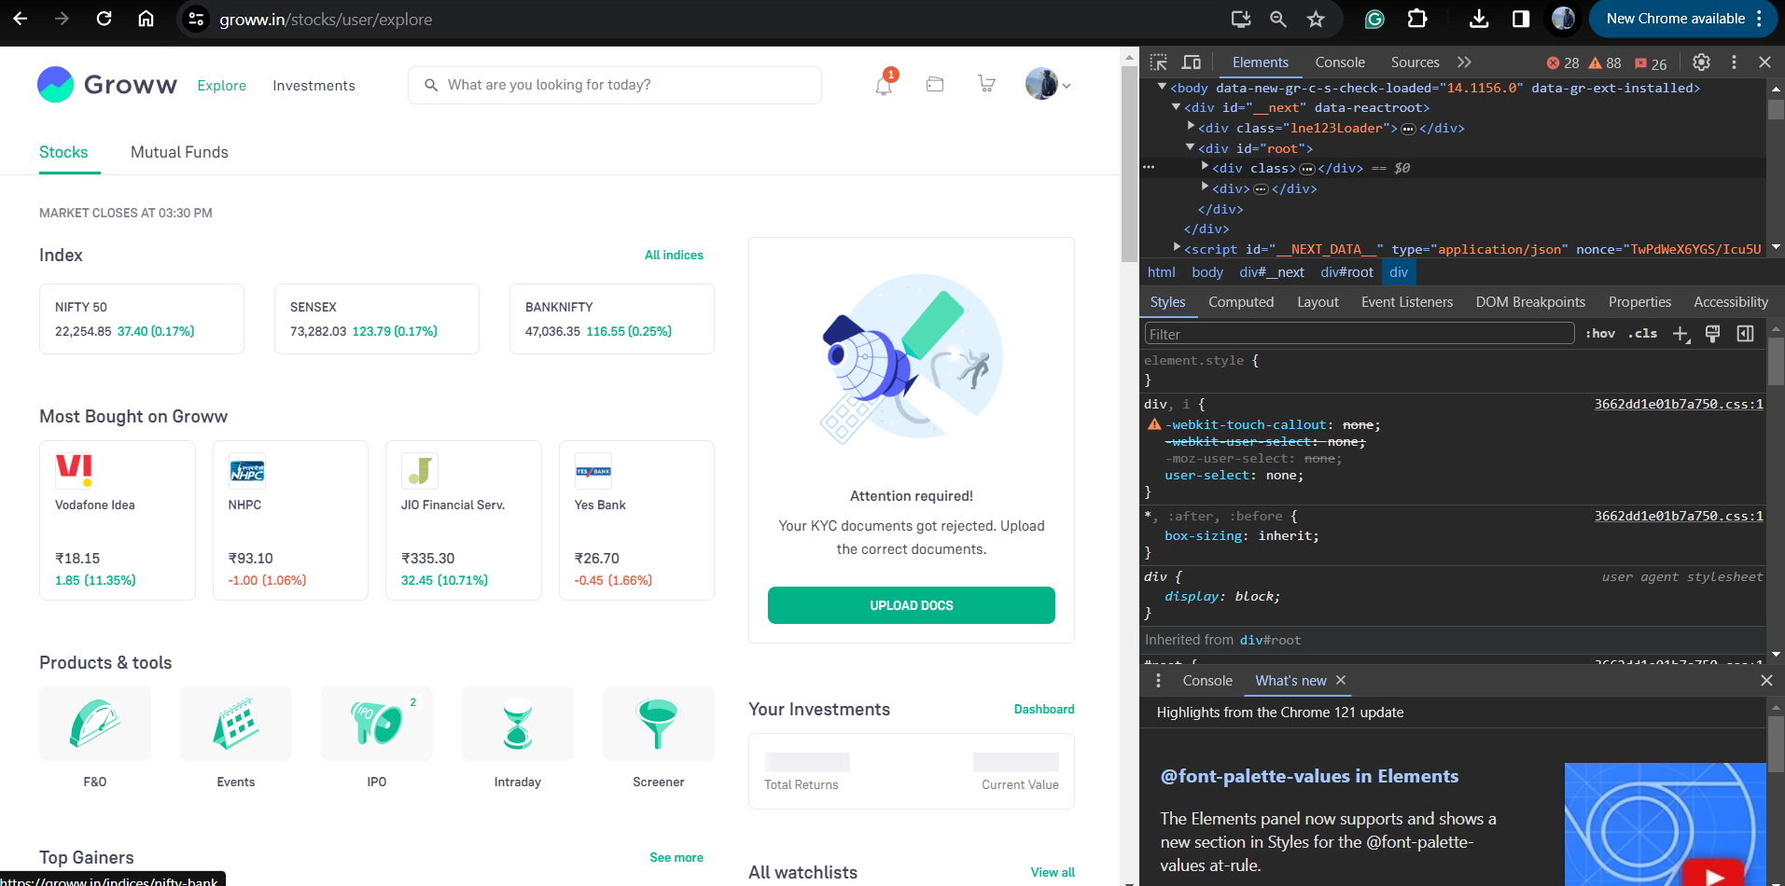
Website Interface with the HTML

Slide 6
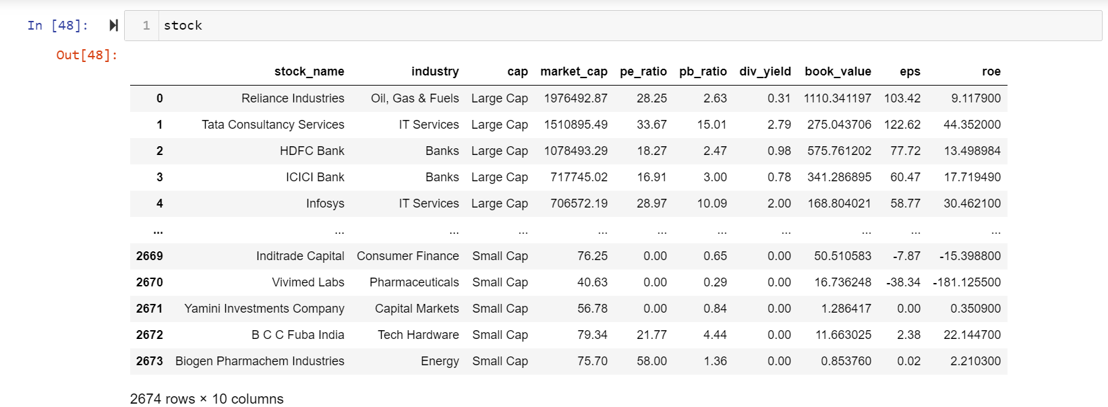
Raw Data
Raw data was extracted from the Website with the columns of market_cap, pe_ratio, pb_ratio, div_yield, book_value, eps and roe

Slide 7
What is market_cap?
Market cap—or market capitalization—refers to the total value of all a company's shares of stock.
What is pe_ratio?
Price to Earnings Ratio or Price to Earnings Multiple is the ratio of share price of a stock to its earnings per share (EPS).
What is dividend_yield?
Dividend yield is a ratio that shows you how much income you earn in dividend payouts per year for every rupee invested in a stock
What is pb_ratio?
The P/ B Ratio represents the relationship between the market's perception of a company's value (reflected in its stock price) and the company's book value (the net asset value of the company's assets minus liabilities).
What is Book_value?
Book value is the value of a company's total assets minus its total liabilities.
What is eps?
Earnings per share or EPS is a common metric used to carry out corporate value. It can be defined as the value of earnings per outstanding share of common stock of the company.

Slide 8
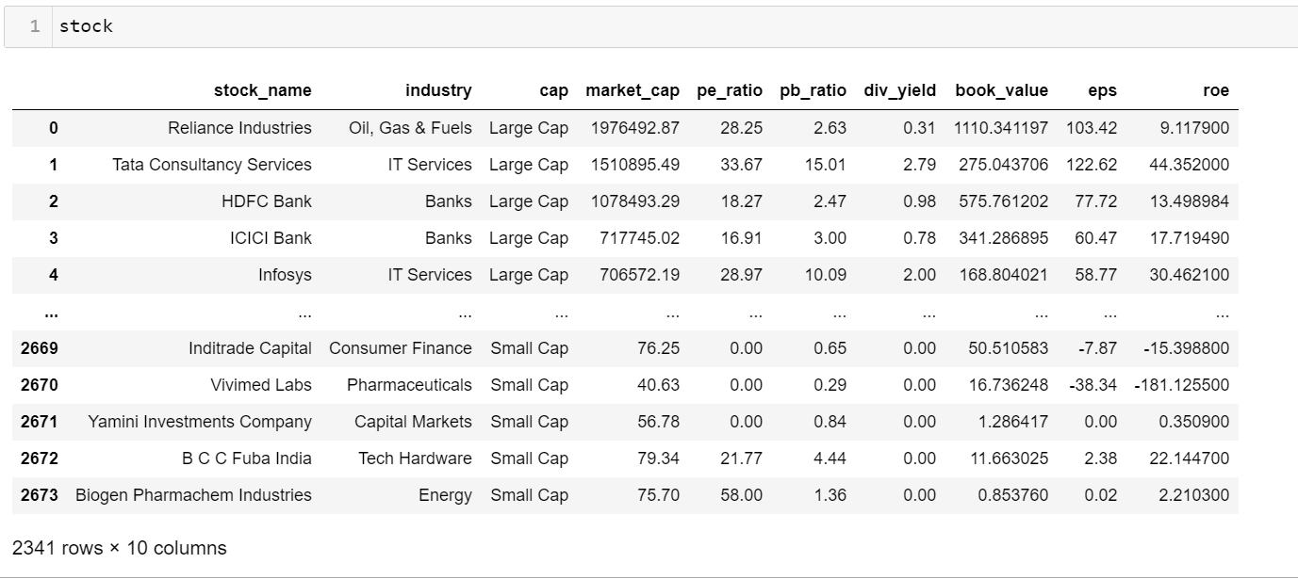
Cleaned Data

Slide 9
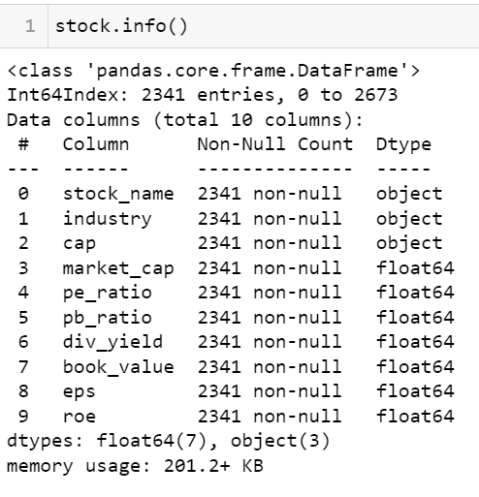
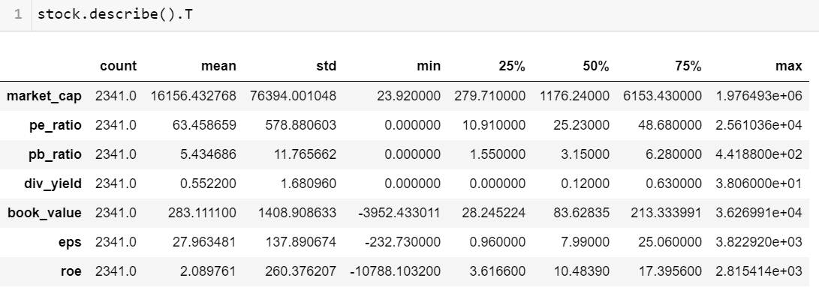
Data Exploration
The data was cleaned by removing the all the null values and duplicate values in the data.

Slide 10
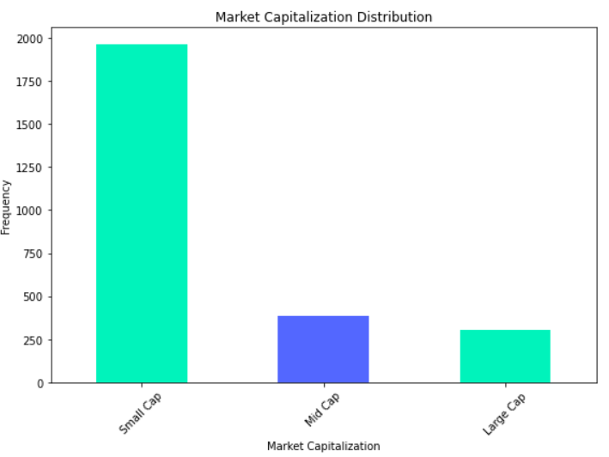
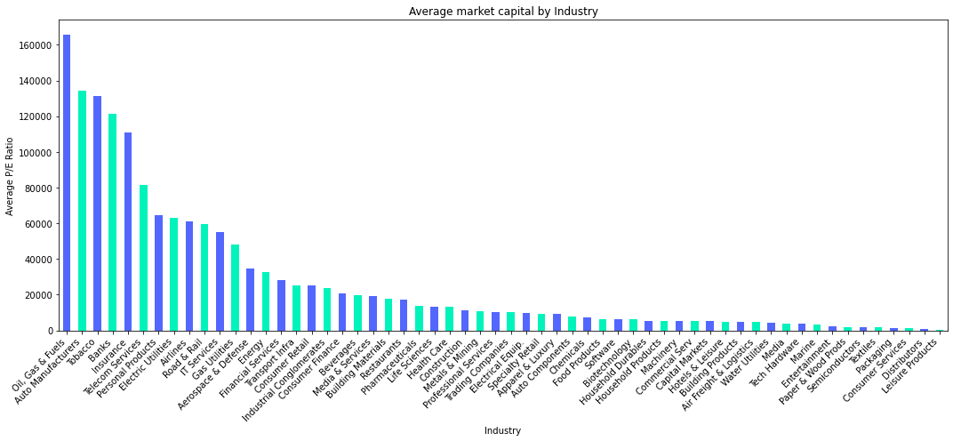
Market Capitalization Distribution:
The total market capital was divided among three different cap size
The graph shows the number of companies listed between the Large, Mid and Small
The below graph represents the Market capital wise among the industry wise, this data help to understand the top industries which are leading the market of India.

Slide 11
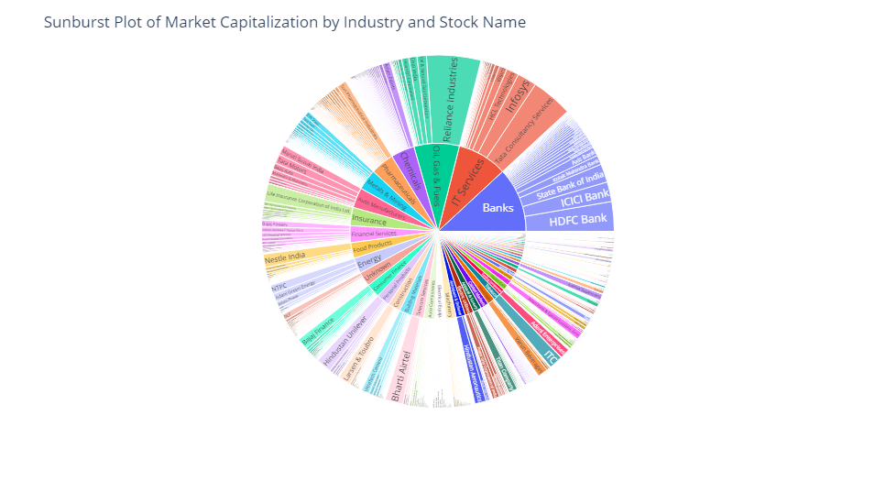
Overview of Industry wise Companies with Market cap:
file:///C:/Users/Vamshi/Downloads/sunburst_plot.html

Slide 12
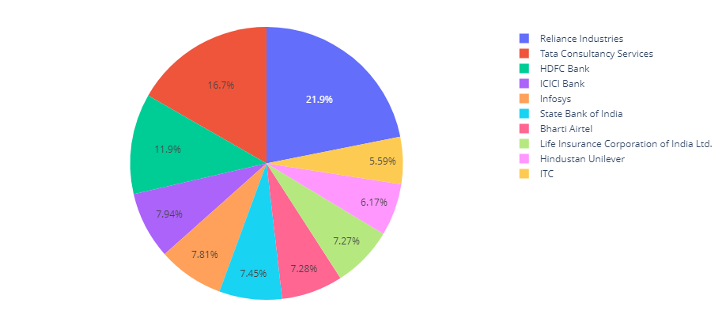
Top 10 Highest Stock Companies of Market Capitalization

Slide 13
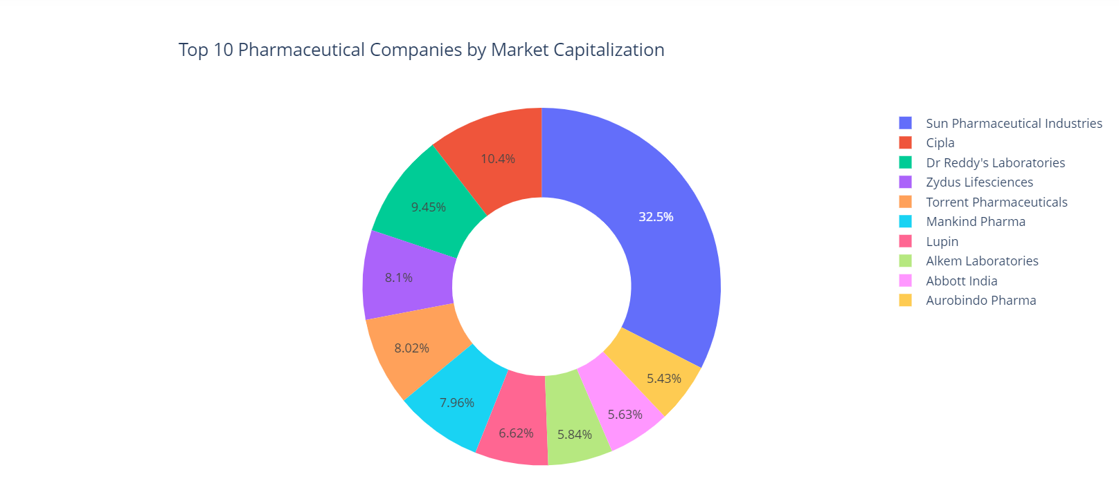
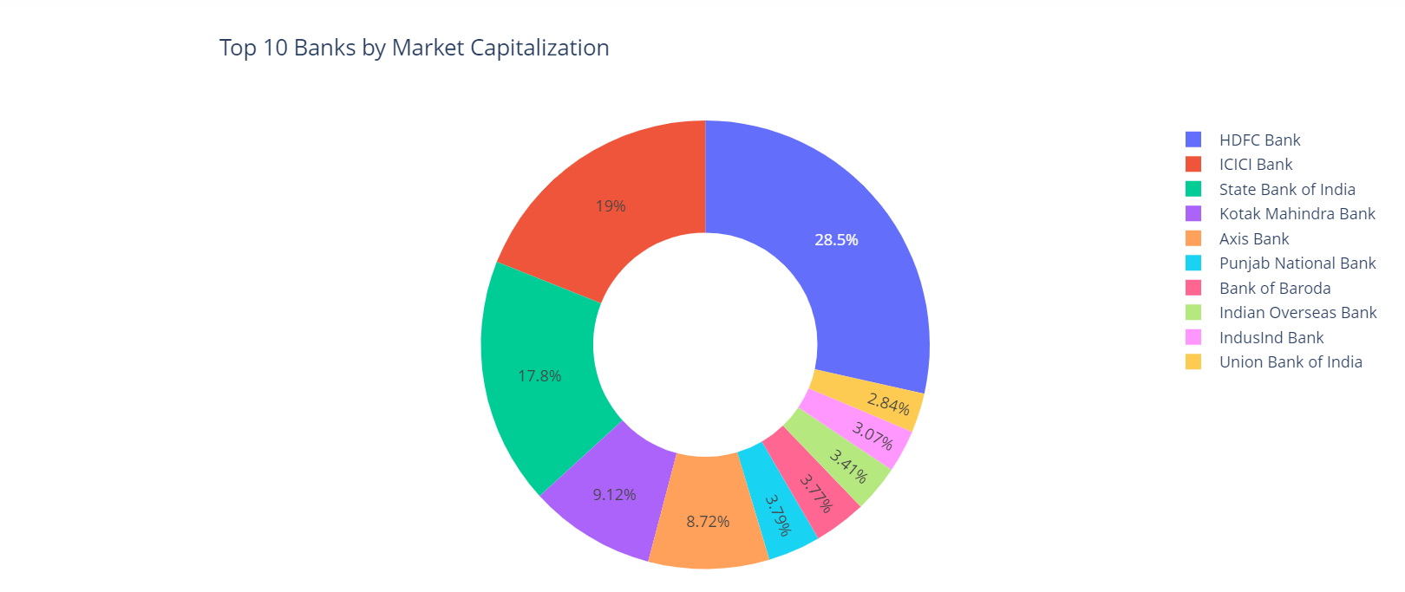
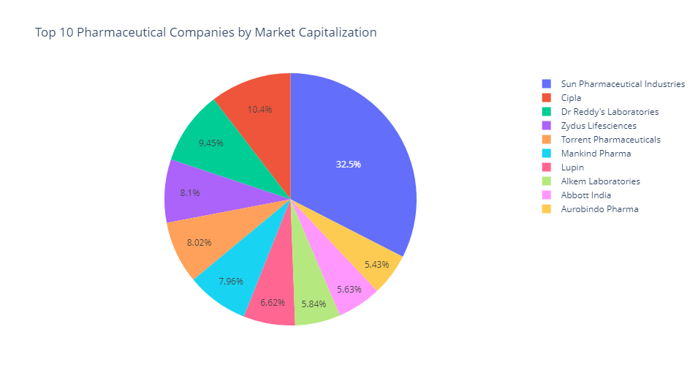
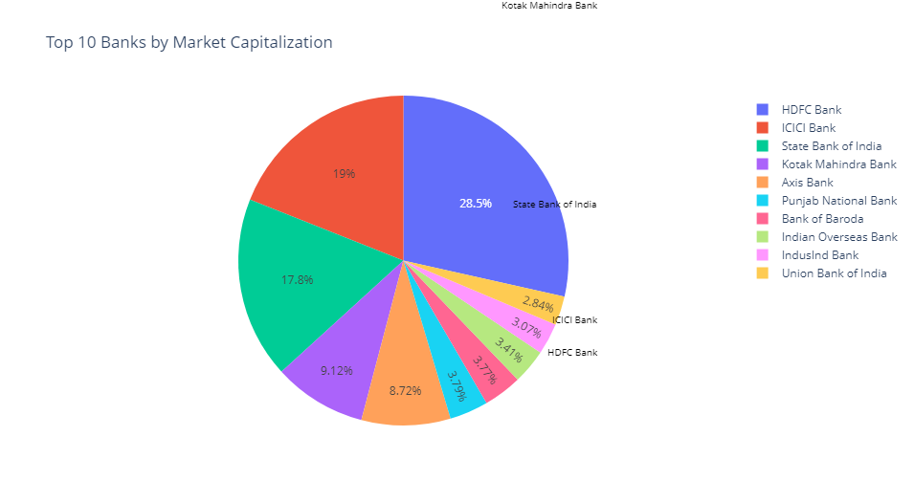
Top 10 Pharmaceuticals Companies by Market Capitalization
Top 10 Banks by Market Capitalization

Slide 14
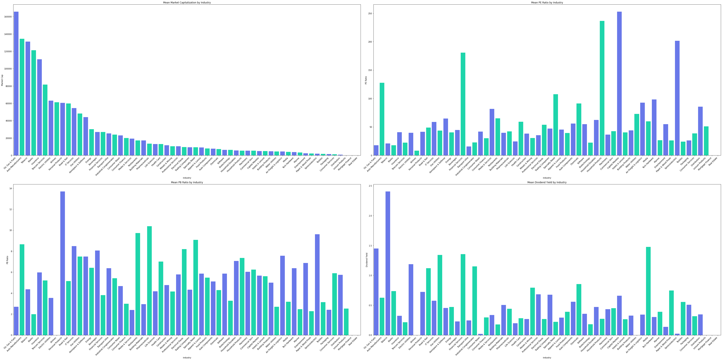
The graphs represent the data of Average of P/E ratio, P/B Ratio and Dividend yields.
Top industry in P/E Ratio(Price-to Earnings): Capital Markets
Top industry in P/B Ratio(Price-to Book): Personal Products
Top industry in Dividends yields: Tobacco

Slide 15
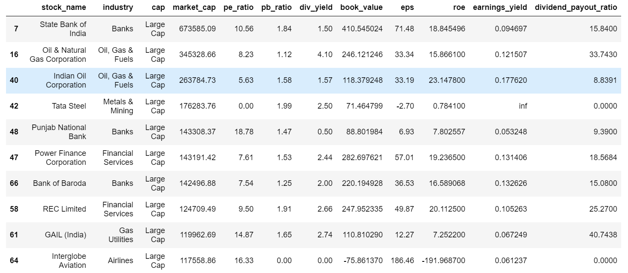
The following are the top performers in the Stock market :
Data has been calculated on the basis of the total cap size, low P/E ratio and low P/B ratio
The following stocks are large cap size as they are considered for long term holdings in a portfolio

Slide 16
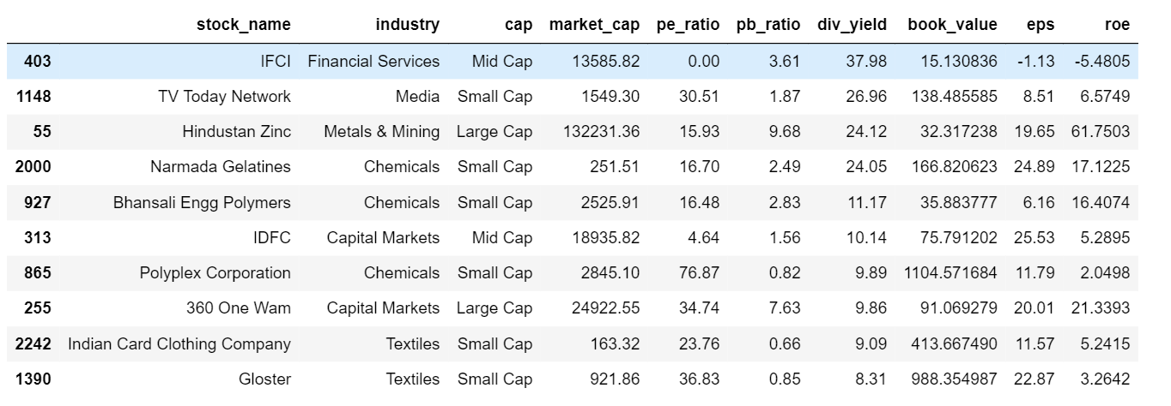
The following are the top dividends paying in the Stock market :
Data has been calculated on the basis of the dividends yield.
The following stocks are top dividend payers in the current financial year
There may be risk factor in this top stocks as there are small cap which will impact huge price fluctuations in any change of the market conditions.

Slide 17
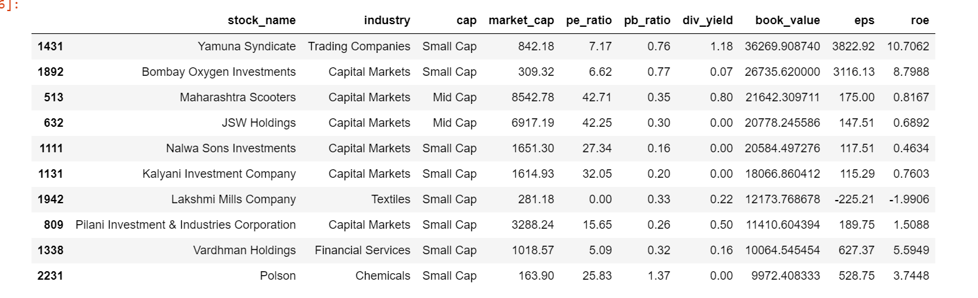
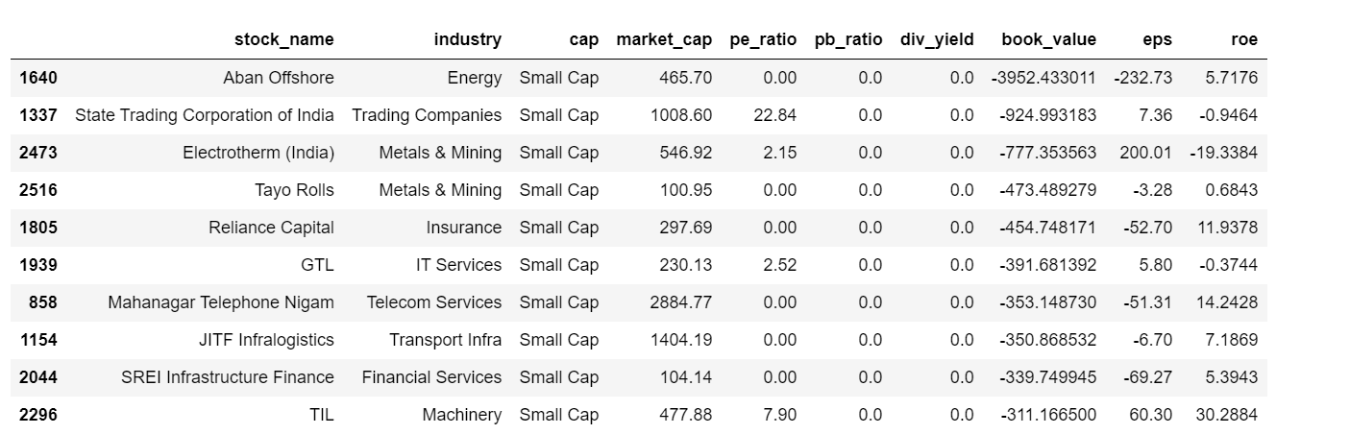
The top and bottom companies in book values:

Slide 18
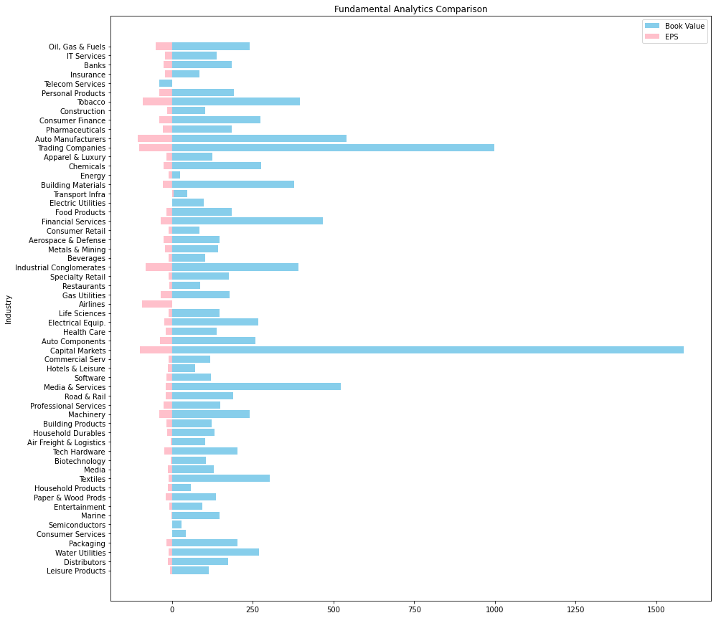
This Population graph shows the company performance between Earning per share and Book Value:
From the graph we can see the Capital Markets and Trading companies with high Book value and EPS (Earning per Share).
From safer side after the top contenders, the Auto Manufactures and Tobacco can be invested.

Slide 19
Conclusion:
Stocks are subjected to market risks
Research the market and stock performance before investing on any stocks
Do the fundamental analysis to grab an overview
Investing in Large Cap companies will be for long run
Special Thanks to,
Abhilash Manikanta sir
Saomya sir
Chaitanya sir
and BhanuPrakash sir.

Slide 20

Thank You!

